Slide 1

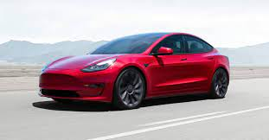
Used Cars Price Prediction
Orly Salama-Alber
Ilia Prizker
Shay Ben Haim

Slide 2
The Problem
The Data
Our goal is to produce a model which may estimate the price of a given car, by analyzing the data features produced by our EDA.
https://www.kaggle.com/austinreese/craigslist-carstrucks-data
Contains 426,880 lines and 26 columns of cars postings originates from the craigslist website.
Columns indicates for a car’s price, manufacturer, model, odometer (Km), number of cylinders, condition, year, fuel, etc.
Link to Jupyter notebook:
https://colab.research.google.com/drive/1tYVlt__VRqp5LPu_hIM0_Yavk3WLK4FP#scrollTo=Dz8LTu6hbuWi

Slide 3
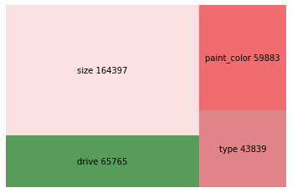
The Features
EDA
Pre Processing
Knowledge Data
Feature Engineering

Slide 4
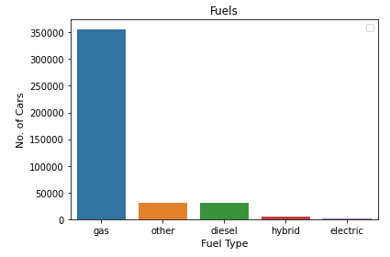
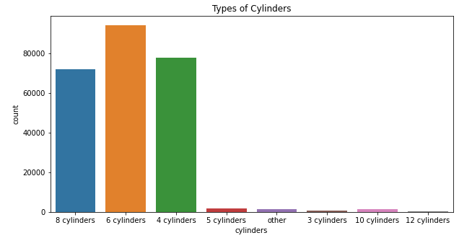
The Features

Slide 5
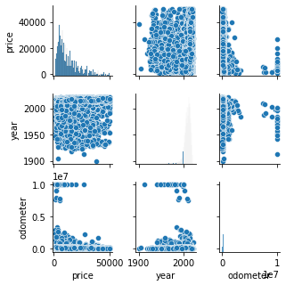
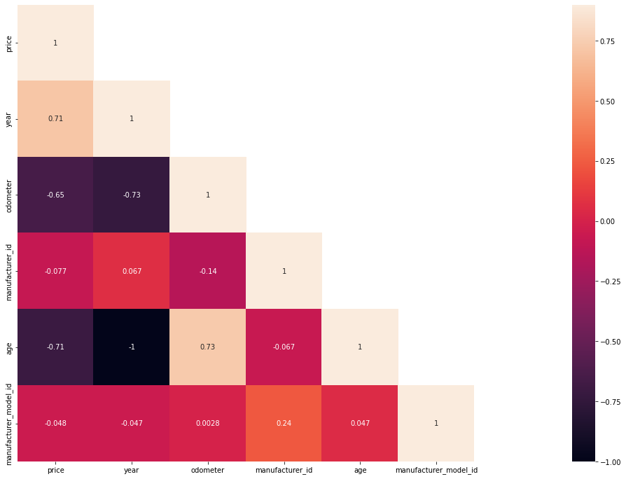
The Features

Slide 6
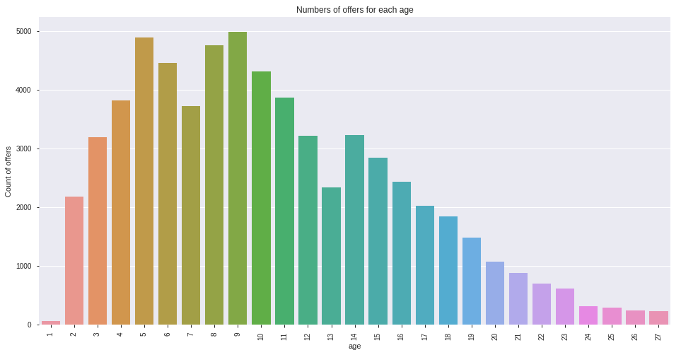
The Features

Slide 7
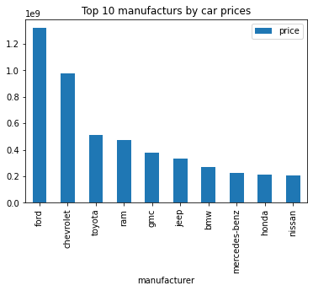
The Features

Slide 8
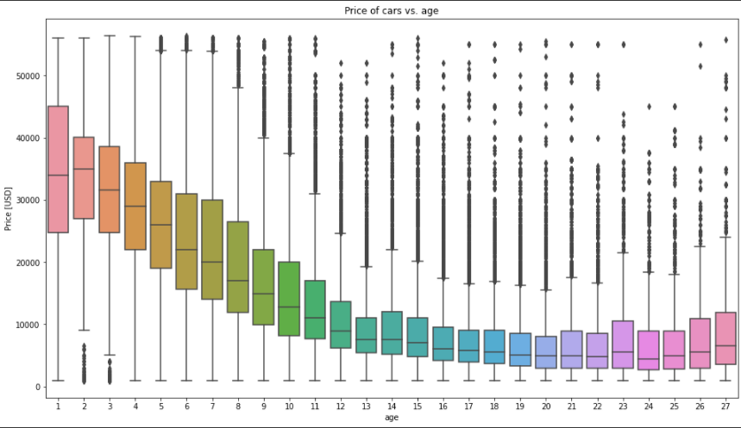
The Features
EDA,
Pre Processing,
Knowledge Data
Feature Engineering

Slide 9
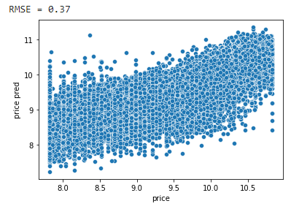
The Model - Linear Regression
Predicted price vs. real price
whereas X contains:
cylinders
odometer
transmission
age
manufacturer + model
condition (4)
size (5)
drive (4)
type (13)
RMSE = 0.37

Slide 10

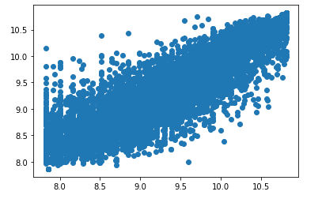
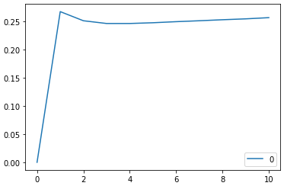
The Model - KNeighborsRegressor
Num Neighbors VS RMSE
RMSE = 0.24

Slide 11
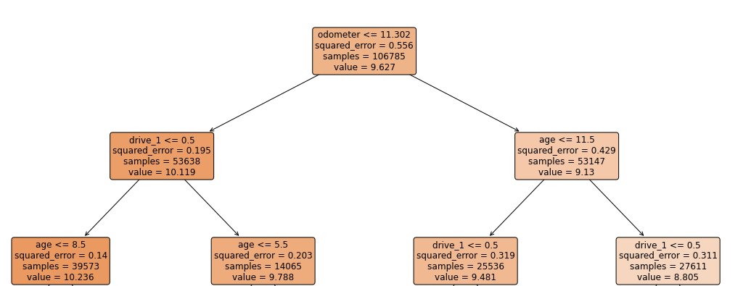
The Model - Decision Tree Regression
max_depth = 15, RMSE = 0.28
result
Random Forest Regressor
max_depth = 15, RMSE = 0.24

Slide 12
What’s Next…
Target aggregation
Cross validation
Additional testing with different parameters for the decision tree or other models
Additional feature engineering

